Slide 1
Estimation
SE423: Software Project Management

Slide 2
Outline
Estimation
Estimation Methodologies
Activity Resource Estimating
Activity Duration Estimating
Function Points
COCOMO
Final Notes

Slide 3
Estimation

Slide 4
Estimation
Very difficult to do, but needed often
Created, used or refined during
  Strategic planning
  Feasibility study and/or SOW
  Proposals
  Vendor and sub-contractor evaluation
  Project planning (iteratively)
Basic process
  Estimate the size of the product
  Estimate the effort (person-months)
  Estimate the schedule
  NOTE: Not all of these steps are always explicitly performed

Slide 5
Estimation
Remember, an “exact estimate” is an oxymoron
Estimate how long will it take you to get home from class today
  On what basis did you do that?
  Experience right?
  Likely as an “average” probability
  For most software projects there is no such ‘average’
Most software estimations are off by 25-100%

Slide 6
Estimation
Target vs. Committed Dates
  Target: Proposed by business or marketing
    Do not commit to this too soon!
  Committed: Team agrees to this
    After you’ve developed a schedule
Size:
  Small projects (10-99 FPs), variance of 7% from post-requirements estimates
  Medium (100-999 FPs), 22% variance
  Large (1000-9999 FPs) 38% variance
  Very large (> 10K FPs) 51% variance

Slide 7
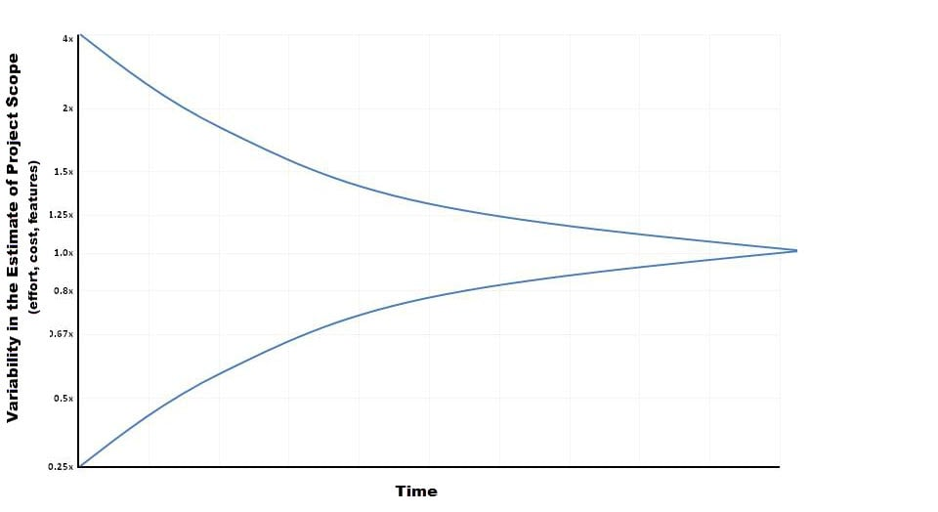
Cone of Uncertainty

Slide 8
Estimation Methodologies

Slide 9
Estimation Methodologies
Expert Judgment
Top-down
Bottom-up
Analogy
Priced to Win (request for quote – RFQ)
Parametric or Algorithmic Method
  Using formulas and equations

Slide 10
Expert Judgment
Use somebody who has recent experience on a similar project
You get a “guesstimate”
Accuracy depends on their ‘real’ expertise
Comparable application(s) must be accurately chosen

Slide 11
Top-down Estimation
Based on overall characteristics of project
  Some of the others can be “types” of top-down (Analogy, Expert Judgment, and Algorithmic methods)
Advantages
  Easy to calculate
  Effective early on (like initial cost estimates)
Disadvantages
  Some models are questionable or may not fit
  Less accurate because it doesn’t look at details

Slide 12
Bottom-up Estimation
Create WBS – Work Breakdown Structure, identify individual tasks to be done.
Add from the bottom-up
Advantages
  Works well if activities well understood
Disadvantages
  Specific activities not always known
  More time consuming

Slide 13
Estimation by Analogy
Use past project
  Must be sufficiently similar (technology, type, organization)
  Find comparable attributes (ex: # of inputs/outputs)
Advantages
  Based on actual historical data
Disadvantages
  Difficulty ‘matching’ project types
  Prior data may have been mis-measured
  How to measure differences – no two exactly same

Slide 14
Priced to Win
Just follow other estimates
Save on doing full estimate
Needs information on other estimates (or prices)
Purchaser must closely watch trade-offs
Priced to lose?

Slide 15
Algorithmic Measures
Lines of Code (LOC)
Function points
  Feature points or object points
Other possible
  Number of bubbles on a DFD
  Number of ERD entities
  Number of processes on a structure chart
LOC and function points most common (of the algorithmic approaches)
Majority of projects use none of the above

Slide 16
Wideband Delphi
Group consensus approach
Rand Corp. used orig. Delphi approach in the 1940’s to predict future technologies
Present experts with a problem and response form
Conduct group discussion, collect anonymous opinions, then feedback
Conduct another discussion & iterate until consensus
Advantages
  Easy, inexpensive, utilizes expertise of several people
  Does not require historical data
Disadvantages
  Difficult to repeat
  May fail to reach consensus, reach wrong one, or all may have same bias

Slide 17
Code-based Estimates
LOC Advantages
  Commonly understood metric
  Permits specific comparison
  Actuals easily measured
LOC Disadvantages
  Difficult to estimate early in cycle
  Counts vary by language
  Many costs not considered (ex: requirements)
  Programmers may be rewarded based on this
    Can use: # defects/# LOC
  Code generators produce excess code

Slide 18
LOC Estimates Issues
How do you know how many in advance?
What about different languages?
What about programmer style?
Stat: avg. programmer productivity: 3,000 LOC/yr
Most algorithmic approaches are more effective after requirements (or have to be after)

Slide 19
Function Points
Software size should be measured by number & complexity of functions it performs
More methodical than LOC counts
House analogy
  House's Square Feet ~= Software LOC
  # Bedrooms & Baths ~= Function points
  Former is size only, latter is size & function
Four basic steps

Slide 20
Function Point Process
Count # of business functions per category
  Categories: outputs, inputs, db inquiries, files or data structures, and interfaces
Establish Complexity Factor for each and apply
  Simple, Average, Complex
  Set a weighting multiplier for each (0 –>15)
  This results in the “unadjusted function-point total”
Compute an “influence multiplier” and apply
  It ranges from 0.65 to 1.35; is based on 14 factors
Results in “function point total”
  This can be used in comparative estimates

Slide 21
Effort Estimation
Now that you know the “size”, determine the “effort” needed to build it
Various models: empirical, mathematical, subjective
Expressed in units of duration
  person-months (or ‘staff-months’ now)
Efficiency/productivity of people
  Motivation
  Ability of team
  Application experience
  Range of personnel

Slide 22
Duration
What is the duration?
The duration of a project is the elapsed time in business working days, not including weekends, holidays, or other nonworking days.
Duration is different from work effort.
  Work effort is labor required to complete an activity. That labor can be consecutive or nonconsecutive hours.
  Duration is work effort divided by number of people doing the work:
  Or, work effort is the duration multiplied by the number of people doing the work
  E.g. five people reviewing a document; the duration may be 10 hours but the work effort is 50 staff-hours

Slide 23
Duration
When we talk about estimates and duration, there are two types of time that are not the same:
  Labor Time
  Clock time
For example, if we estimate that a task would require 40 hours of labor to complete, then in a normal business setting we need at least 50 business hours, Why?

Slide 24
Duration
Your average business day may include few of the following activities or perhaps a number of each:
  Meetings – non-project related
  Phone calls
  E-mails
  Coffee breaks
  Lunches
  Friendly chat with your teammates
The duration of the activity is the clock time or “Elapsed time” that we want to estimate.
Productivity is usually 50-75% of a business day

Slide 25
Variation in Activity Duration
Since we cannot know what factors will be effective when work is underway on an activity, we cannot know exactly how long it will take.
One of the goals in estimating the activity duration is to define the activity to a level of granularity that estimates have a narrow variance; the estimate is as good as you can get it at the planning stages of the project.
There are several causes of variation in the actual activity duration:
  Varying skill levels – see Journal Exercise
  Unexpected events
  Efficiency of work time
  Mistakes and Misunderstandings

Slide 26
Causes of Variation
Causes of Variation in the Actual Activity Duration
Varying skill levels. Our estimate of the activity duration is based on average skilled engineer. We may get a higher or lower skilled engineer assigned to the activity, causing the actual duration to vary from the planned duration.
Unexpected events. Random acts of nature, vendor delays, traffic jams, power failures, etc.
Efficiency of work time. Every time a worker is interrupted it takes more time to get up to the level of productivity prior to the time of the interruption. These interruptions may have little or substantial impact on the worker's productivity
Mistakes and Misunderstandings. In organizations that have a documented process, rework may have its toll on the actual activity duration.

Slide 27
Estimation Issues
Quality estimations needed early but information is limited
Precise estimation data available at end but not needed
  Or is it? What about the next project?
  Should have determined just how accurate your original estimate was.
Best estimates are based on past experience
Politics of estimation:
  You may anticipate a “cut” by upper management
For many software projects there is little or no data for estimation
  Technologies change
  Historical data unavailable
  Wide variance in project experiences/types
  Subjective nature of software estimation

Slide 28
Over and Under Estimation
Over estimation issues
  The project will not be funded
    Conservative estimates guaranteeing 100% success may mean funding probability of zero.
  Parkinson's Law: Work expands to take the time allowed
  Danger of feature and scope creep
  Be aware of “double-padding”: team member + manager
Under estimation issues
  Quality issues (short changing key phases like testing)
  Inability to meet deadlines
  Morale and other team motivation issues

Slide 29
Activity Resource Estimating

Slide 30
Introduction
Resource estimating is concerned with who/what, how much, and when
Who/what
  Resource requirements of people or equipment
  Matching the right resources to activities
  May be generic (n Java programmers) or resource-specific (Richard Parker as senior architect)
How much. Amount of resource(s) needed for activity
When. When the resource will be needed for activities

Slide 31
Introduction
Controlling factors in resource estimating
  Enterprise environment May be defined by constraints and assumptions identified in Project Scope Statement
  Organization policy How the organization allocates and manages resources from within and from without
    Note: Enterprise environment and organization policy may be closely-coupled
  Resource availability When the resource will be available for activities and whether dedicated or part-time

Slide 32
Estimating tools
Expert judgment One of the most effective tools for estimating. May be used in conjunction with other tools
Alternative analysis Examines different approaches to applying resources, such as in-house development vs. contracting vs. COTS
Published estimating data May be available in-house in form of historical project data or may be available from outside sources (e.g. unclassified U.S. Government-funded projects)

Slide 33
Estimating tools
Project management software PM software can provide automated assistance in defining resources, calendars, rates, etc.
Bottom-up estimating
  Use if activity is a natural work package but still complex
  Decompose activity into more manageable (estimable) pieces
  Adhere to 100% rule: sum of activities should exactly equal work package (mind the scope!)
  Example: Architectural quality and cost/benefit analysis (ATAM and CBAM)

Slide 34
Activity Resource Estimating Output
Activity resource requirements
  Identify what and how much of resource(s) are needed for each activity in a work package
  Activity resource requirements are summed to provide estimate for entire work package
Resource calendar
  Documents working and non-working days
  Resource-specific holidays may be identified
Requested changes
  Activity resource estimating process may generate requests for changes to activity list
  Processed within the Integrated Change Control process

Slide 35
Activity Duration Estimating

Slide 36
Introduction
Focuses on estimating the number of work periods needed to complete individual schedule activities
Estimates originate from person or groups most familiar with the type of work needed in the activity
Estimate is progressively elaborated: duration estimates are improved as project progresses
Activity duration output
  Quantitative activity duration estimates, including range of possible values

Slide 37
Introduction
Controlling factors in duration estimating
  Historical data If available, enterprise- or industry-specific historical data can be used as starting point for estimates
  Activity resource requirements The type and number of resources applied to an activity must account for
    Resource qualifications
    Quantity-quality productivity trade-offs: putting more people on a task may reduce productivity
  Resource calendars Must account for full/part time commitments

Slide 38
A useful rule of thumb
Keep all times in the same units
Don't mix increments
  Example: Schedule everything in hours, then convert to days and fractions as a last step
  Note: Most PM software tools enforce this rule by using a uniform time unit and increment

Slide 39
Estimating tools
Expert judgment As in resource estimating, one of the most effective tools for estimating. May be used in conjunction with other tools
Analogous estimating Estimation based on similar activities performed in a previous project
  Most useful if both activity and project are more similar than different
  Document similarities and differences
  Example: Developing the database schema for a project in the same domain and of similar scope

Slide 40
Estimating tools
Reserve analysis Contingency or time reserves can be added to schedule to allow for schedule risks
  Contingency reserves may be used or adjusted as more precise project information becomes available
  Aka buffer time. Do not confuse with slack time.
Three-point estimating techniques use a mathematical combination of three different estimates: Most likely, Optimistic, and Pessimistic
  There are variations in defining each of these estimates among different techniques

Slide 41
Three Point Estimating
Used whenever there is a potential variance in an estimate. Assumes a Gaussian distribution of estimates.
  Duration
  Effort
  Size
Three-point estimating techniques use a mathematical combination of three different estimates:
  Get estimates from experts: Most likely, Optimistic, and Pessimistic
  Compute an average:
  (Optimistic + 4(Likely)+ Pessimistic)/6

Slide 42
Example: Estimation of LOC
CAD program to represent mechanical parts
Estimated LOC = (Optimistic + 4(Likely)+ Pessimistic)/6
Major Software Functions | ID | Optimistic | Most Likely | Pessimistic | Estimated LOC
User interface and control facilities | UICF | 1,500 | 2,300 | 3,100 | 2,300
Two-dimensional geometric analysis | 2DGA | 3,800 | 5,200 | 7,200 | 5,300
Three-dimensional geometric analysis | 3DGA | 4,600 | 6,900 | 8,600 | 6,800
Database management | DBM | 1,600 | 3,500 | 4,500 | 3,350
Computer graphics display features | CGDF | 3,700 | 5,000 | 6,000 | 4,950
Peripheral control | PC | 1,400 | 2,200 | 2,400 | 2,100
Design analysis modules | DAM | 7,200 | 8,300 | 10,000 | 8,400
Estimated lines of code |  | 23,800 | 33,400 | 41,800 | 33,200

Slide 43
Function Points

Slide 44
Function Points
Software size measured by number & complexity of functions it performs
More methodical than LOC counts
House analogy
  House’s Square Feet ~= Software LOC
  # Bedrooms & Baths ~= Function points
  Former is size only, latter is size & function
Six basic steps

Slide 45
Function Points Process
Count # of business functions per category
  Categories: outputs, inputs, db inquiries, files or data structures, and interfaces
Establish Complexity Factor for each and apply
  Simple, Average, Complex
  Set a weighting multiplier for each (0->15)
  This results in the “unadjusted function-point total”
Compute an “influence multiplier” and apply
  It ranges from 0.65 to 1.35; is based on 14 factors
Results in “function point total”
  This can be used in comparative estimates

Slide 46
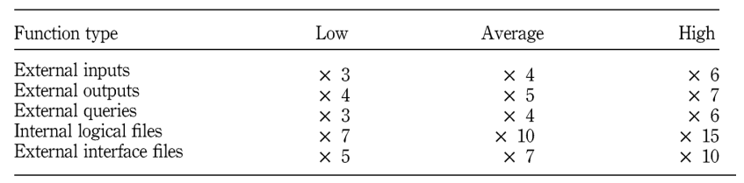
Function Points Estimation
Each function is divided into one of five categories, then multiplied by the appropriate number below

Slide 47
COCOMO

Slide 48
COnstructive COst Model (COCOMO)
COnstructive COst MOdel
An algorithmic software cost estimation model
Uses a basic regression formula with parameters that are derived from historical project data and current project characteristics
Input – LOC, Output - Person Months
Allows for the type of application, size, and “Cost Drivers”
Cost drivers using High/Med/Low & include
  Motivation, Ability of team, Application experience, etc.
Biggest weakness?
  Requires input of a product size estimate in LOC

Slide 49
Basic COCOMO – Effort Applied
E = a(KLOC)^{b}
Where
  E is the Effort in staff months
  a and b are coefficients to be determined
  KLOC is thousands of lines of code

Slide 50
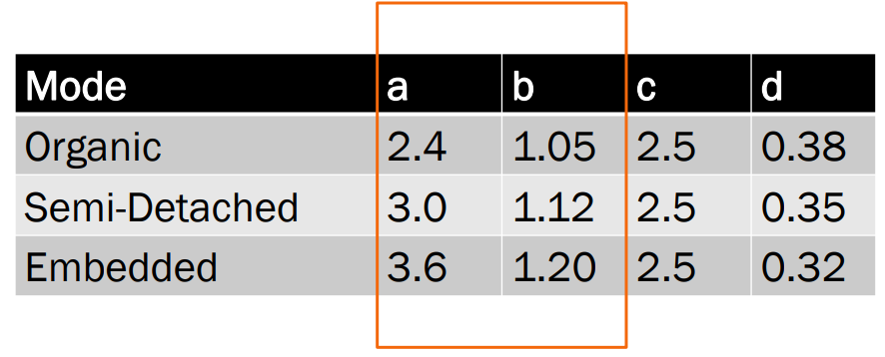
Basic COCOMO – More Constants

Slide 51
Basic COCOMO – The Modes
Organic
  2-50 KLOC, small, stable, little innovation
Semi-detached
  50-300 KLOC, medium-sized, average abilities, medium timeconstraints
Embedded
  > 300 KLOC, large project team, complex, innovative, severe constraints

Slide 52
Basic COCOMO – Example
Suppose size is 200 KLOC
Organic
  2.4(200)1.05= 626 staff-months
Semi-Detached
  3.0(200)1.12= 1,133 staff-months
Embedded
  3.6(200)1.20= 2,077 staff-months

Slide 53
Basic COCOMO – Development Time
TDEV = c(E)^{d}
Where
  TDEV is time for development
  c and d are constants to be determined
  E is the effort

Slide 54
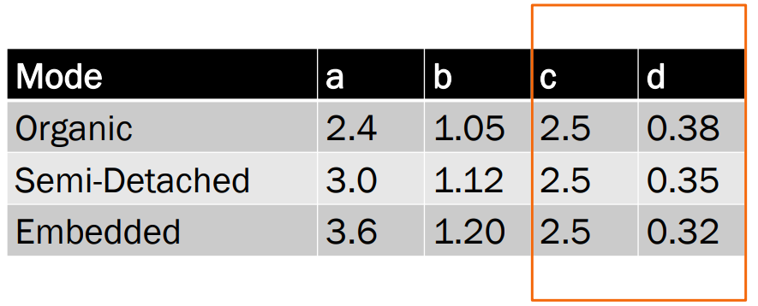
Basic COCOMO – More Constants

Slide 55
Basic COCOMO – Example
Suppose size is 200 KLOC
Organic
  E = 626 staff months
  TDEV = 2.5(626)0.38= 29 months
Semi-Detached
  E = 1,133
  TDEV = 2.5(1133)0.35= 29 months
Embedded
  E = 2077
  TDEV = 2.5(2077)0.32= 29 months

Slide 56
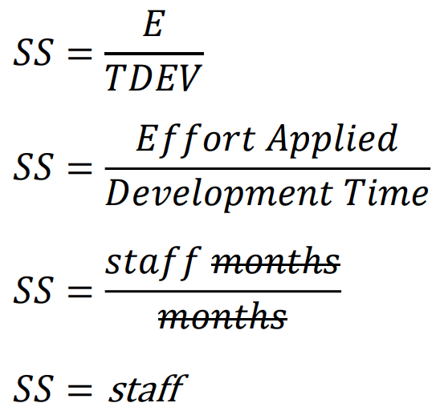
Basic COCOMO – Average Staff Size

Slide 57
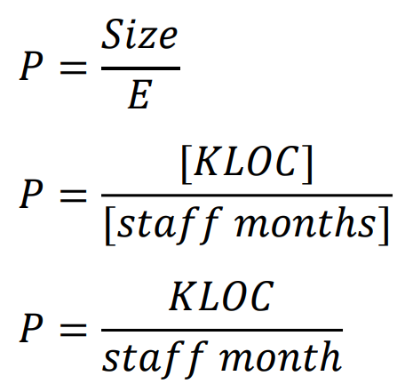
Basic COCOMO – Productivity

Slide 58
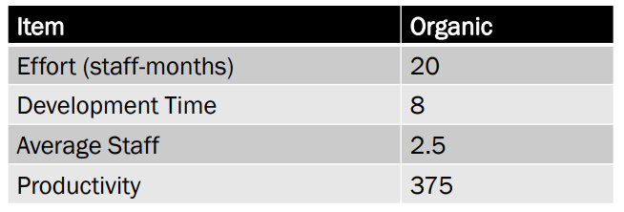
COCOMO Complete Example - Organic
Suppose an organic project has 7.5 KLOC,
  Effort 2.4(7.5)1.05= 20 staff–months
  Development time 2.5(20)0.38= 8 months
  Average staff 20 / 8 = 2.5 staff
  Productivity 7,500 LOC / 20 staff-months = 375 LOC / staff-month

Slide 59
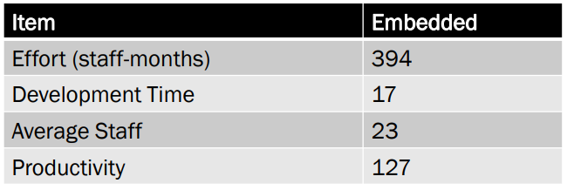
COCOMO Complete Example - Embedded
Suppose an embedded project has 50 KLOC,
  Effort 3.6(50)1.20= 394 staff–months
  Development time 2.5(394)0.32= 17 months
  Average staff 394 / 17 = 23 staff
  Productivity 50,000 LOC / 394 staff-months = 127 LOC / staff-month

Slide 60
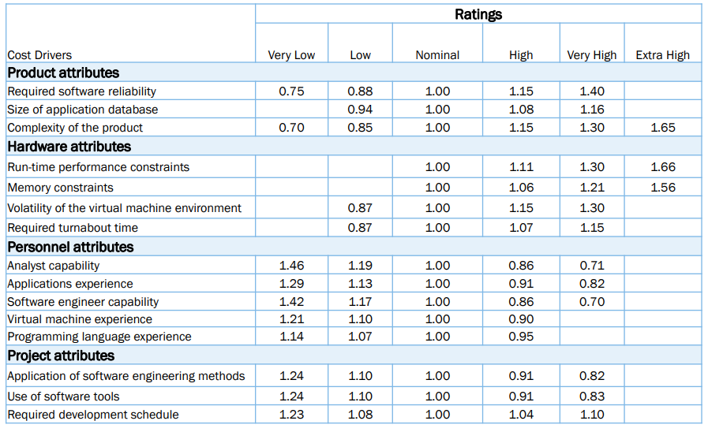
Intermediate COCOMO – Cost Drivers

Slide 61
Intermediate COCOMO – Effort
E = a(KLOC)^{b} x C
Where
  E is the Effort
  a and b are constants as before
  KLOC is thousands of lines of code
  C is the effort adjusted factor

Slide 62
Intermediate COCOMO – Cost Drivers
Intermediate COCOMO introduces Cost Drivers
They are used because
  they are statistically significant to the cost of the project; and
  they are not correlated to the project size (KLOC)
To obtain multiplier
  Determine each number using the grid
  Multiply them – the product is C

Slide 63
COCOMO Advantages
Based on history
Repeatable
Unique adjustment factors
Has different modes
Works well on similar projects
Highly calibrated
Well-documented
Easy to use

Slide 64
COCOMO Limitations
Ignores requirements volatility
Ignores documentation
Ignores customer’s “skill”
Oversimplifies security
Ignores software safety
Ignores personnel turnover
Ignores many hardware issues
Personnel experience may be obsolete
Must know the cost drivers
Must be able to predict project size

Slide 65
Final Notes

Slide 66
Code Reuse and Estimation
Does not come for free
Code types: New, Modified, Reused
If code is more than 50% modified, it’s “new”
Reuse factors have wide range
  Reused code takes 30% effort of new
  Modified is 60% of new
Integration effort with reused code almost as expensive as with new code

Slide 67
Estimation for Agile
Each user scenario is considered separately
The scenario is decomposed into a set of engineering tasks
Each task is estimated separately
  May use historical data, empirical model, or experience
  Scenario volume can be estimated (LOC, FP, use-case count, etc.)
Total scenario estimate computed
  Sum estimates for each task
  Translate volume estimate to effort using historical data
The effort estimates for all scenarios in the increment are summed to get an increment estimate

Slide 68
Know Your Deadlines
Are they ‘Real Deadlines’?
  Tied to an external event
  Have to be met for project to be a success
  Ex: end of financial year, contractual deadline, Y2K
Or ‘Artificial Deadlines’?
  Set by arbitrary authority
  May have some flexibility (if pushed)

Slide 69
Estimation Presentation
How you present the estimation can have huge impact
Techniques
  Plus-or-minus qualifiers
    6 months +/-1 month
  Ranges
    6-8 months
  Risk Quantification
    +/- with added information
    +1 month of new tools not working as expected
    -2 weeks for less delay in hiring new developers
  Cases
    Best / Planned / Current / Worst cases
  Coarse Dates
    Q3 02
  Confidence Factors
    April 1 – 10% probability, July 1 – 50%, etc.

Slide 70
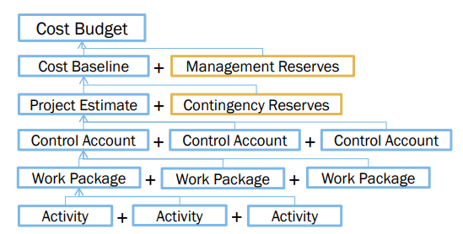
Final Estimates
For Time or Cost Estimates:
  Aggregation into larger units (Work Packages, Control Accounts, etc.)
  Perform Risk Analysis to calculate Contingency Reserves (Controlled by PM)
  Add Management Reserves: Set aside to cover unforeseen risks or changes (Total company funds available – requires Change Control activities to access)

Slide 71
Estimation Guidelines
Estimate iteratively!
  Process of gradual refinement
  Make your best estimates at each planning stage
  Refine estimates and adjust plans iteratively
  Plans and decisions can be refined in response
  Balance: too many revisions vs. too few

Slide 72
Other Estimation Factors
Account for resource experience or skill
  Up to a point
  Often needed more on the “low” end, such as for a new or junior person
Allow for “non-project” time & common tasks
  Meetings, phone calls, web surfing, sick days
There are commercial ‘estimation tools’ available
  They typically require configuration based on past data

Slide 73
Other Estimation Notes
Remember: “manage expectations”
Parkinson’s Law
  “Work expands to fill the time available”
The Student Syndrome
  Procrastination until the last minute (cram)

