Slide 1
Quality
SE423: Software Project Management

Slide 2
Outline
Software Quality
Quality Assurance
Quality Control
Project Success
Measurement and Metrics

Slide 3
Software Quality

Slide 4
Software Quality
A definition of quality should emphasize three important points:
  Software requirements are the foundation from which quality is measured. Lack of conformance to requirement is lack of quality.
  Specified standards define a set of development criteria that guide the manner in which software is engineered. If the criteria are not followed, lack of quality will almost surely result.
  There is a set of implicit requirements that often goes unmentioned (e.g. good maintainability). If software conforms to its explicit requirements but fails to meet implicit requirements, software quality is suspect.

Slide 5
Software Testing
The purpose of software testing is to assess and evaluate the quality of work performed at each step of the software development process.
Although it sometimes seems that way, the purpose of testing is NOT to use up all the remaining budget or schedule resources at the end of a development effort.
The goal of testing is to ensure that the software performs as intended, and to improve software quality, reliability and maintainability.
Software testing is a full-life-cycle assessment of quality

Slide 6
Quality and Testing
A good development process, tools, methods, and people go far in providing quality products
Testing is one aspect of assuring software quality
  It is a measure of quality, it does not deliver quality
“Quality cannot be tested into a product”
Software Quality Assurance includes
  Software engineering process improvement
    Prevent the insertion of defects
  Fault tolerant software design
    Tolerate the existence of defects
  All aspects of software verification and validation
    Including testing

Slide 7
Errors, Defects, Faults and Failures
Failures are usually a result of system errors (which turn into defects) that are derived from faults in the system
However, faults do not necessarily result in system failures
  The faulty system state may be transient and ‘corrected’ before an error arises
Errors do not necessarily lead to system failures
  The error can be corrected by built-in error detection and recovery
  The failure can be protected against by built-in protection facilities
    For example, protect system resources from system errors

Slide 8
Build Time VS Run Time
Defect prevention and reduction
Fault detection and containment
Human (developer) Error
Software Defect (bug)
Build time
System
Fault
System
Failure
Run time
Latent (dormant) defect

Slide 9
Verification VS Validation
Verification:
  “Are we building the product right?”
  The software should conform to its design
Validation:
  “Are we building the right product?”
    Validate requirements
  “Did we build the right product?”
    Validate implementation
  The software should do what the user really requires
V&V: Build the right product and build it right!

Slide 10
The V&V Process
V&V is a whole life-cycle process
  V & V must be applied at each stage in the software process
V&V has two principal objectives
  The discovery of defects in a system
  The assessment of whether or not the system is usable in an operational situation

Slide 11
Static and Dynamic V&V Activities
Software testing:
  Concerned with exercising and observing product behavior
  Dynamic V&V
Software inspections:
  Concerned with studying software product artifacts to discover defects
  Static V&V
  May be supplemented by tool-based (semi-automated) document and code analysis

Slide 12
V&V Confidence
Depends on:
  System’s purpose
    Criticality of software function
    Mission critical (organization depends on it)
    Safety critical
    Societal impact
  User expectations
  Marketing environment
Cost-benefit trade-offs
  High confidence is expensive. Is it necessary?

Slide 13
How Do you plan for V&V
At each stage of the software development process, there are activities that should be done which will help develop the testing plans and test cases
Remember: V&V is expensive.
  Plan to do it right the first time!

Slide 14
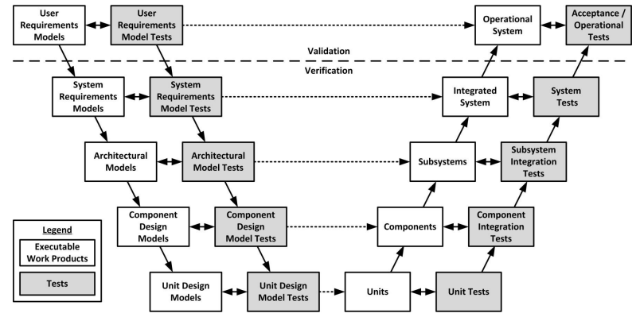
The V Model
Plan and develop tests throughout the life cycle
Implement tests when there is an implementation ready to test
Iterative and incremental: Repeat “V” at each iteration

Slide 15
Quality Assurance

Slide 16
Goal of Quality Assurance
Quality assurance (QA) activities strive to ensure:
  Few, if any, defects remain in the software system when it is delivered
  Remaining defects will cause minimal disruptions or damages

Slide 17
Planning Quality
The following need to be considered: Scope, Stakeholders, Risks, Internal and External Environmental Factors, Process
Project-specific standards and procedures are created
  Based on quality standards for each deliverable
  Includes how PM activities themselves should be done
  Plans/Project must comply with external standards (CISG, ISO 9000, OSHA, etc)
  Plans/Project must comply with organizational standards
  Plans/Project must meet the customer’s quality standards
  Tracking / Proof may be needed (metrics, measurements, etc.)

Slide 18
QA Techniques Classification
Defect Prevention
  Remove (human) error sources
  Block defects from being injected into software artifacts
Defect Reduction
  Detect defects
    Inspection
    Testing
  Remove defects
    Debugging—iterate on the software engineering activity
    Rework requirements, design, code, etc.
Defect Containment
  Fault tolerance
  Fault containment

Slide 19
Defect Prevention
Remove the root causes of errors
Education and training address human misconceptions that cause errors
  Domain and product knowledge
  Software engineering process
  Technology knowledge
Formal methods can help identify and correct imprecise specifications, designs and implementations
Standards conformance, use of best practices and patterns can help prevent fault injection

Slide 20
Defect Reduction
Discover and remove defects
Inspection: direct fault detection
  requirements, design, code, manuals, test cases
Testing: failure observation and fault isolation
  Execute the software and observe failures
  Use execution history/records to analyze and locate fault(s) and defect(s) causing the failure

Slide 21
Defect Reduction - Issues with Testing
Need implemented software to execute
Need software instrumentation, execution history to:
  isolate faults
  trace to defects
Impossible to test everything
  Expensive to test most things
Risk of too much and not enough testing
  Use project risks to guide investment

Slide 22
Defect Reduction - Testing Sweet Spot
Quantity
Number of missed defects
Cost of testing
Amount of Testing
Under-testing
Optimal Amount of Testing
Over-testing

Slide 23
Defect Reduction - Risk
Denotes a potential negative impact that may arise from some present process or from some future event.
What is your risk exposure to a defect that is hidden?
  Likelihood of defect existence
  Likelihood of failure occurrence
  Impact if failure occurs
Risk exposure determines ...
  Testing priority
  Testing depth
  What to test and not to test

Slide 24
Defect Containment
Software fault tolerance
  Safety-critical or mission-critical software often must be fault tolerant
    The system can continue in operation in spite of a fault occurrence
  Techniques: exception handling, recovery blocks
Software failure containment
  Fault detection and isolation
  Techniques:
    safety interlocks,
    physical containment (barriers),
    disaster planning, etc.

Slide 25
Example
Input to Software Development
Software System
Faults
Usage Scenarios and Results
Failures
Error
Sources
e1
e2
e3
e4
f1
f2
x1
Failure
Containment
f3
x2
e5
f4
e6
Error
Removal
Fault
Removal
Failure
Prevention
a b
“a” causes “b” defect barrier/remover
Legend
a
a
removal of “a”
presence of “a”

Slide 26
Quality Control
Notes:
Deming, W. Edwards. Out of the Crisis, MIT Center for Advanced Engineering Study, 1992.
Dr. Deming was invited to participate in the reconstruction of Japan after World War II.
His goal was to not repeat the mistakes made by American corporations. In the 1940s,
many of America's manufacturers started to adopt statistical quality control processes,
but these efforts only solved individual problems. Quality Control departments were
created to track quality using control charts and statistics. However, this action took
quality control away from everyone else. Deming felt this was wrong, as "quality control
is everyone's job." Instead, quality control departments were now putting out fires, rather
than focusing on process improvements.

Slide 27
Perform quality control
Perform quality control is concerned with monitoring specific project results for compliance with quality standards
Performed throughout project
May also include taking control actions to correct causes of quality problems
Perform quality assurance is the process that provides the framework of activities and standards for performing quality control

Slide 28
Software Quality Assurance Group
The group should prepare an SQA plan for a project.
The plan identifies
  evaluations to be performed
  audits and reviews to be performed
  standards that are applicable to the project
  procedures for error reporting and tracking
  procedures for change management
  documents to be produced by the SQA group
  amount of feedback provided to the software project team

Slide 29
Software Quality Assurance Group
Participates in the development of the project’s software process description
Reviews software engineering activities to verify compliance with the defined software process.
Audits designated software work products to verify compliance with those defined as part of the software process.
Ensures that deviations in software work and work products are documented and handled according to a documented procedure.
Records any noncompliance and reports to senior management.

Slide 30
Software Quality Assurance
The area of Software Quality Assurance can be broken down into a number of smaller areas such as
  quality of planning,
  formal technical reviews,
  Testing
  and
  training.
Here we take a look at Formal Technical Review methods and Testing ...

Slide 31
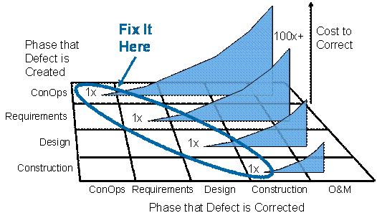
Formal Technical Reviews
Software quality assurance activity performed by software engineers to:
  Uncover errors in function, logic, implementation.
  Verify that the software meets requirements.
  Represented using correct standards.
  Achieve uniformity.
  Manage projects.
Walkthroughs
Inspections (Code Reading)
Round-robin reviews

Slide 32
Formal Technical Reviews
Walkthroughs
  The least formal and most common kind of review is the walkthrough, which is any meeting at which two or more developers review technical work with the purpose of improving its quality.
  Walkthroughs are useful to rapid development because you can use them to detect defects earlier than you can with testing.
Notes:
http://www.stevemcconnell.com/articles/art04.htm
The least formal and most common kind of review is the walkthrough, which is any meeting at
which two or more developers review technical work with the purpose of improving its quality.
Walkthroughs are useful to rapid development because you can use them to detect defects earlier
than you can with testing.
Code reading is a somewhat more formal review process than a walkthrough but nominally
applies only to code. In code reading, the author of the code hands out source listings to two or
more reviewers. The reviewers read the code and report any errors to the code's author.
Inspections are the most formal kind of technical review, and they have been found to be
extremely effective in detecting defects throughout a project. Developers are trained in the use
of inspection techniques and play specific roles during the inspection process. The "moderator"
hands out the material to be inspected before the inspection meeting. The "reviewers" examine
the material before the meeting and use checklists to stimulate their reviews. During the
inspection meeting, the "author" paraphrases the material, the reviewers identify errors, and the
"scribe" records the errors. After the meeting, the moderator produces an inspection report that
describes each defect and indicates what will be done about it. Throughout the inspection process
you gather data about defects, hours spent correcting defects, and hours spent on inspections so
that you can analyze the effectiveness of your software-development process and improve it.
http://alumnus.caltech.edu/~leif/OO/ReviewTraining.html
Round Robin
Each reviewer gets to present their comments on the product. The reviewers present one
comment at a time. The person to the left of the leader starts, the reviewer to their left goes next,
and so on, around the table (telephonic attendees are assigned an arbitrary order).

Slide 33
Formal Technical Reviews
Inspections and Code Reading
  Code reading is a somewhat more formal review process than a walkthrough but nominally applies only to code.
  In code reading, the author of the code hands out source listings to two or more reviewers. The reviewers read the code and report any errors to the code's author.
Notes:
http://www.stevemcconnell.com/articles/art04.htm
The least formal and most common kind of review is the walkthrough, which is any meeting at
which two or more developers review technical work with the purpose of improving its quality.
Walkthroughs are useful to rapid development because you can use them to detect defects earlier
than you can with testing.
Code reading is a somewhat more formal review process than a walkthrough but nominally
applies only to code. In code reading, the author of the code hands out source listings to two or
more reviewers. The reviewers read the code and report any errors to the code's author.
Inspections are the most formal kind of technical review, and they have been found to be
extremely effective in detecting defects throughout a project. Developers are trained in the use
of inspection techniques and play specific roles during the inspection process. The "moderator"
hands out the material to be inspected before the inspection meeting. The "reviewers" examine
the material before the meeting and use checklists to stimulate their reviews. During the
inspection meeting, the "author" paraphrases the material, the reviewers identify errors, and the
"scribe" records the errors. After the meeting, the moderator produces an inspection report that
describes each defect and indicates what will be done about it. Throughout the inspection process
you gather data about defects, hours spent correcting defects, and hours spent on inspections so
that you can analyze the effectiveness of your software-development process and improve it.
http://alumnus.caltech.edu/~leif/OO/ReviewTraining.html
Round Robin
Each reviewer gets to present their comments on the product. The reviewers present one
comment at a time. The person to the left of the leader starts, the reviewer to their left goes next,
and so on, around the table (telephonic attendees are assigned an arbitrary order).

Slide 34
“QA” & Testing
Testing “Phases”
  Unit
  Integration
  System
  User Acceptance Testing
Testing Types
  Black-box
  White-box
Static vs. Dynamic Testing
Automated Testing
  Pros and cons
Defect tracking
Integration: 2 types
  Top down
  Bottom up

Slide 35
Defect Rates
In general, defect rate is the number of defects over the opportunities for errors during a specified time frame
Defect rate found during formal machine testing is usually positively correlated with defect rate experienced in the field
Tracking defects and rates allow us to determine the quality of the product and how mature it is.

Slide 36
Defect Metrics
Open Bugs (outstanding defects)
  Ranked by severity
Open Rates
  How many new bugs over a period of time
Close Rates
  How many closed (fixed or resolved) over that same period
  Ex: 10 bugs/day
Change Rate
  Number of times the same issue updated
Fix Failed Counts
  Fixes that didn’t really fix (still open)
  One measure of “vibration” in project

Slide 37
Defect Metrics
Why do we measure defects? Why do we track the defect count when monitoring the execution of software projects? What does this tell us?
Defect counts indicate how well the system is implemented and how effectively testing is finding defects.
  Low defect counts may mean that testing is not uncovering defects.
  Defect counts that continue to be high over time may indicate a larger problem,
    inaccurate requirements, incomplete design and coding, premature testing, lack of application knowledge, or inadequately trained team.
Defect trends provide a basis for deciding on when testing has completed. When the number of defects found falls dramatically, given a constant level of testing, the product is becoming stable and moving to the next phase is feasible.
Notes:
We track defect count when monitoring the execution of the software projects to analyze how well our system which we have implemented is working; i.e. the system efficiency. We all know that the main goal of testing is not to make the entire code bug free ( its impossible) rather the goal is to identify and reduce the number of defects or errors as much as possible so that the task can be identified as "complete".
Tracking the defect count helps us ensure that the testing phase was conducted properly and completely. If, during counting, more defects are founds, it might indicate issues such as incomplete design task , testing phase not conducted properly, unskilled workforce etc. Thus, once the team obtains a certain number of defects at a constant rate after improving the above mentioned causes of errors, then they can assign the task to be complete and can move on to next task.

Slide 38
The Rayleigh Distribution
If we graph defects over time they will show a Rayleigh distribution
R_{c} =
k is a constant representing the time at which defects peak.
Note the tail to the distribution.
We see this same curve in other areas as well.
  Specifically in reliability and quality.
t
e^{-t2/2k2}
k²
Defect frequency
k
Time
Notes:
Schach p 254.

Slide 39
Basic tools of quality
Cause-and-effect (fishbone, Ishikawa) diagram
  Shows the relationship between the effects of problems and their causes
Process flowcharts
  Graphical representation of a project process that can help identify where problems occur
Control chart
  Maps the variation of a project variable (e.g. number of defects) as a function of time relative to a baseline value and within boundaries of ±3σ
    Baseline may be established after sufficient project variable data are available
  Acceptable upper and lower boundaries of variable values are called the Upper Control Limit (UCL) and Lower Control Limit (LCL), respectively

Slide 40
Basic tools of quality
Control Chart
Upper Control Limit
+3σ
+2σ
+1σ
Number of Defects
Baseline value
-1σ
-2σ
-3σ
Lower Control Limit
Baseline establishment
Time

Slide 41
Histogram
A graphic representation of frequency counts of a sample or population
X-axis lists the unit intervals of a parameter like defect severity level and Y-axis contains frequency counts
Purpose is to show the distribution characteristics of the parameter
6
Number of Defects
4
2
Team A
Team B
Team C
Team D
Histogram

Slide 42
Pareto Diagram
A frequency bar chart in descending order by types of problems or defects
X-axis is usually the defect cause and Y-axis is the defect count
Identifies the few causes that account for the majority of defects
Commonly see a 80-20 pattern -- 80% of the defects from 20% of the causes
12
100
10
75
8
Number of Defects
% of Defects
6
50
4
25
2
Team C
Team A
Team B
Team D
Pareto Chart

Slide 43
Run Charts
Tracks the performance of the parameter of interest over time
X-axis is time and Y-axis is the value of the parameter
Best used for trend analysis
Especially useful if historical data is available for comparisons with the current trend
Frequently used for project management
A run chart is a more general version of a control chart: it is mostly used for trend analysis rather than project control decisions. Look for patterns.

Slide 44
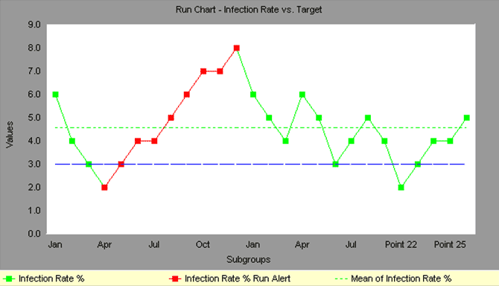
Run Chart
Notes:
Run Charts, also known as line graphs, display process performance over time. Run Charts Six Sigma, as sometimes they called, are one of the primary quality tools used in process improvement.
Upward and downward trends, cycles, and large aberrations may be spotted and investigated further. In a run chart, events, shown on the y axis, are graphed against a time period on the x axis.
For example, a run chart in a hospital might plot the number of patient transfer delays against the time of day or day of the week. The results might show that there are more delays at noon than at 3 p.m. Investigating this phenomenon could point to potential improvement needs.
Run charts can also be used to track improvements that have been put into place, checking to determine their success. For example, a Before/After chart can be displayed as a run chart.
Also, an average line can be added to a run chart to clarify movement of the data away from the average.

Slide 45
Scatter Diagram
Vividly portrays the relationship of two variables, if any.
For a cause-effect relationship, the X-axis is the independent variable and the Y-axis is for the dependent variable
Each point represents an observation of both variables
x-y plot showing the relationship between two project variables
Aid in looking for relationships between two variables
A mathematical equation representing relationship between variables can be found using regression analysis (simple or multivariate)
Scatter plots are useful for finding direct or indirect relationships which can then be used to analyze/improve quality.
Correlation is not causation!!

Slide 46
Project Duration Scatter Diagram
Notes:
Quickly see if two variables are related.
Go for quick and dirty numbers.
Correlation is not causality. A relationship does not indicate a direct connection only that Variable 1 influences Variable 2 - there may be a deeper connection.
Find the relationship quickly!

Slide 47
Project Success

Slide 48
Think Small
Keep requirements tight & focused
One milestone at a time
Smaller, incremental chunks
As simple as possible but no simpler

Slide 49
Process Spectrum
Too much medicine can kill the patient
Process
Spectrum
Chaos
Bureaucracy
Balance is crucial

Slide 50
Miscellaneous
Be Disciplined and Professional
Learn to say “No”
  Be polite but firm
The Value of Versions
  “We will put that in phase 2”
An Ounce of Prevention
Paralysis
Analysis Paralysis
  Over-process
  Nothing gets finished
  65% of software professionals have experienced this
Paralysis Paranoia
  Fear of over-process = process avoidance

Slide 51
Miscellaneous
MBWA – Management by Walk About
  Shows you’re actually involved day-to-day
  Recognizes individuals may say more 1-on-1
  Allows spontaneity
  Finds personnel problems sooner
Delegate
  Don’t be a “Control Freak”
  You need to be the “hub” but not everything
Project Home Page
  Give your project an intranet page
  Central repository for project status, documents and other resources

Slide 52
Success Metrics
On schedule
  Requires good: plan; estimation; control
Within budget
  Again: planning, estimation & control
According to requirements
  Importance of good requirements
  Perception & negotiation critical
High quality. May or may not be same as item 3
Only real measure:
  Is the customer happy?
  Customer satisfaction!!

Slide 53
Why Do Projects Succeed?
How to identify a project’s success potential
  What metrics could you look at?
    Project size
    Project duration
    Project team size

Slide 54
Why Do Projects Succeed?
Executive support
User involvement
Experienced project manager
Clear business objectives
Minimized scope
Standard software infrastructure
Firm basic requirements
Formal methodology
Reliable estimates

Slide 55
Why Executive Support?
Top management can help to:
  Secure adequate resources
  Get approval for unique project needs in a timely manner
  Receive cooperation from people throughout the organization
  Provide leadership guidance

Slide 56
State of the Practice in Software Management
Factors that may influence the success or failure of the software projects could be:
  Social Factors
  Technology
Notes:
56

Slide 57
State of the Practice in Software Management
Technologies on Unsuccessful Projects
No historical software measurement data
Failure to use automated estimating tool
Failure to use automated planning tool
Failure to monitor progress or milestones
Failure to use effective architecture
Failure to use effective development methods
Failure to use design reviews
Failure to use code inspections
Failure to include formal risk management
Informal, inadequate testing
Manual design and specification
More than 30% creep in user requirements
Technologies on Successful Projects
Accurate software measurement
Early use of estimating tools
Continuous use of planning tool
Formal progress reporting
Formal architecture planning
Formal development methods
Formal design reviews
Formal code inspections
Formal risk management
Formal testing methods
Automated design and specification
Automated configuration control
Less than 10% creep in requirements
Notes:
57

Slide 58
State of the Practice in Software Management
Social Factors on Unsuccessful Projects
Excessive schedule pressure
Executive rejection of estimates
Severe friction with clients
Divisive corporate politics
Poor team communications
Naïve senior executives
Project management malpractice
Unqualified technical staff
Generalists used for critical tasks: quality assurance, testing, planning, estimating
Social factors on Successful Projects
Realistic schedule pressure
Executive understanding of estimates
Cooperation with clients
Congruent management goals
Excellent team communications
Experienced senior executives
Capable Project management
Capable technical staff
Specialists used for critical tasks: quality assurance, testing, planning, estimating
Notes:
58

Slide 59
How to ensure a project fails
Do the same things you did on the last project. Over and over and over.
Don't listen to your experts. After all the last project worked out okay (mostly)
Don't measure progress with metrics. The only thing that counts is "did you meet the delivery date?".
Set delivery dates with the customer but not with the developers. Developers can meet any schedule we ask for.
Don't use new tools. Keep using the ones we used ten, twenty years ago.
Spend your time making sure people do it your way.
Office politics and vendettas are more important than the project.

Slide 60
Measurement and Metrics

Slide 61
Measurement and Metrics
“Not everything that can be counted counts, and not everything that counts can be counted.”
- Albert Einstein

Slide 62
Why Measurement and Metrics?
Software measurement is concerned with deriving a quantitative (numeric) value for an attribute of a software product or process (largely qualitative)
This allows for objective comparisons between techniques and processes
Although some companies have introduced measurement programs, the systematic use of measurement is still uncommon
There are few standards in this area

Slide 63
Definitions
Measure
  provides a quantitative indication of the size of some product or process attribute
Measurement
  the act of obtaining a measure
Metric
  a quantitative measure of the degree to which a system, component, or process possesses a given attribute

Slide 64
Software Metric
Any type of measurement which relates to a software system, process or related documentation
  Lines of code in a program, number of person-days required to develop a component
Allow the software and the software process to be quantified
Measures of the software process or product
May be used to predict product attributes or to control the software process

Slide 65
Categories
Product
  Assess the quality of the design and construction of the software product being built.
Process & Project
  Quantitative measures that enable software engineers to gain insight into the efficiency of the software process and the projects conducted using the process framework

Slide 66
Process Metrics
Private process metrics (e.g., defect rates by individual or module) are only known to by the individual or team concerned.
Public process metrics enable organizations to make strategic changes to improve the software process.
Metrics should not be used to evaluate the performance of individuals.
Statistical software process improvement helps and organization to discover where they are strong and where they are weak

Slide 67
Product Metrics
A quality metric should be a predictor of product quality
Classes of product metric
  Dynamic metrics which are collected by measurements made of a program in execution
  Static metrics which are collected by measurements made of the system representations
  Dynamic metrics help assess efficiency and reliability; Static metrics help assess complexity, understandability and maintainability

Slide 68
Project Metrics
A software team can use software project metrics to adapt project workflow and technical activities
Project metrics are used to avoid development schedule delays, to mitigate potential risks, and to assess product quality on an on-going basis
Every project should measure its inputs (resources), outputs (deliverables), and results (effectiveness of deliverables)

Slide 69
Metrics Assumptions
A software property can be measured
The relationship exists between what we can measure and what we want to know
This relationship has been formalized and validated
It may be difficult to relate what can be measured to desirable quality attributes

Slide 70
Integrating Metrics with Process
Many software developers do not collect measures.
Without measurement it is impossible to determine whether a process is improving or not
Baseline metrics data should be collected from a large, representative sampling of past software projects
Getting this historic project data is very difficult, if the previous developers did not collect data in an on-going manner

Slide 71
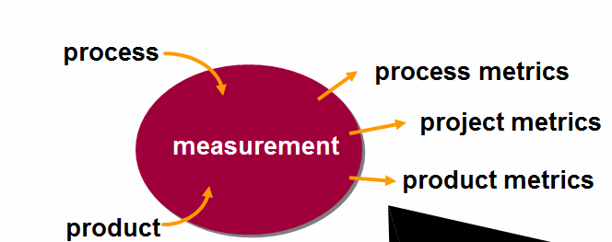
Software Measurement
Direct measures of a software engineering process include cost and effort
Direct measures of the product include lines of code (LOC), execution speed, memory size, defects reported over some time period
Indirect product measures examine the quality of the software product itself (e.g., functionality, complexity, efficiency, reliability, maintainability)

Slide 72
The Measurement Process
A software measurement process may be part of a quality control process
Data collected during this process should be maintained as an organizational resource
Once a measurement database has been established, comparisons across projects become possible

Slide 73
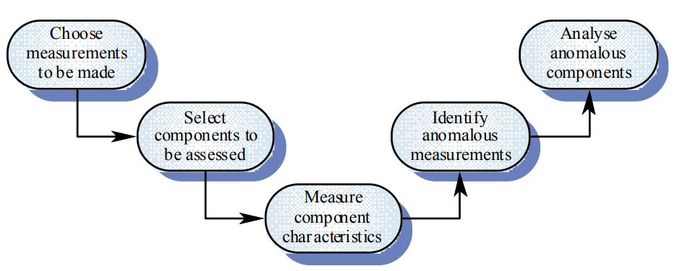
Product Measurement Process

Slide 74
Data Collection
A metrics program should be based on a set of product and process data
Data should be collected immediately (not in retrospect) and, if possible, automatically
Three types of automatic data collection
  Static product analysis
  Dynamic product analysis
  Process data collation

Slide 75
Data Accuracy
Don’t collect unnecessary data
  The questions to be answered should be decided in advance and the required data identified
Tell people why the data is being collected
  It should not be part of personnel evaluation
Don’t rely on memory
  Collect data when it is generated not after a project has finished

Slide 76
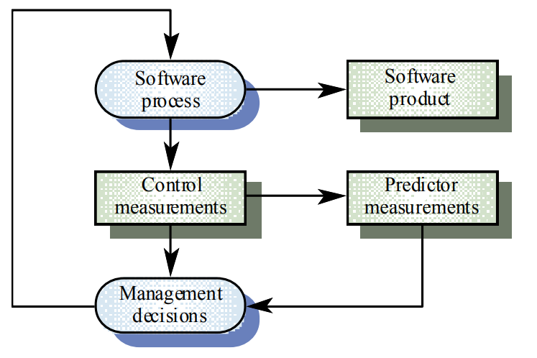
What Are Metrics For?

Slide 77
Analysis
It is not always obvious what data means
  Analyzing collected data is very difficult
Professional statisticians should be consulted if available
Data analysis must take local circumstances into account

Slide 78
Metric Types with Examples
Size-oriented metrics
  Defects, human effort, Line of Code LOC
Function-oriented metrics
  Function points
Web Engineering
  Number of static Web pages (Nsp), Number of dynamic Web pages (Ndp), Customization index: C = Nsp / (Ndp + Nsp)
Product metrics
  Cyclomatic complexity, Fan in/Fan-out

